Slide 1
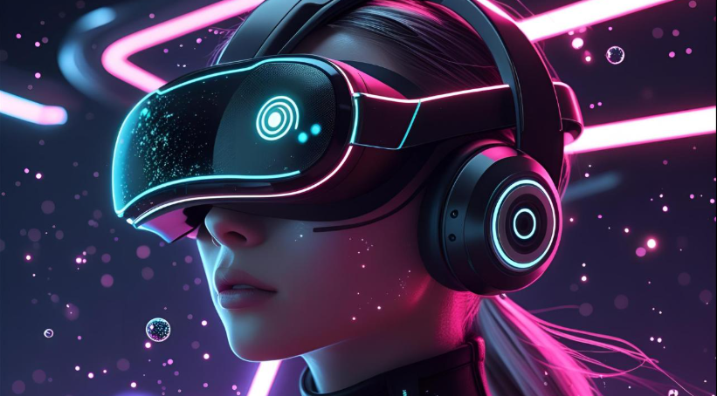
Virtual Reality
DSA0206-COMPUTER VISION WITH OPENCV
SIVADHARSHINI.K-192524008
B.TECH.AI&DS

Slide 2
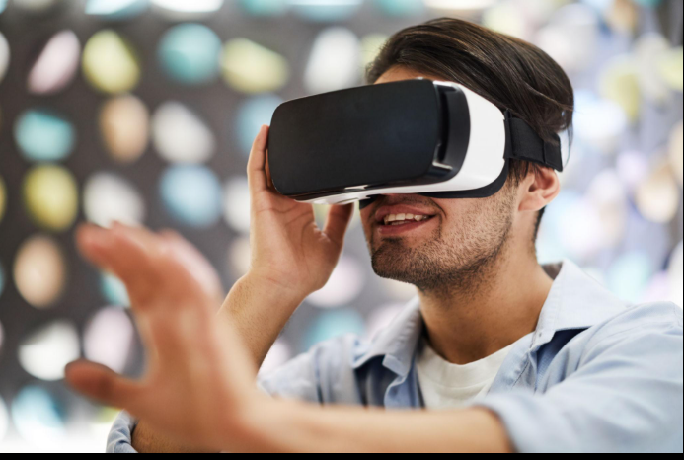
Introduction
What is Virtual Reality?
Virtual Reality (VR) is a computer-generated 3D environment.
It allows users to experience and interact with a virtual world.
Users wear VR headsets to enter the virtual environment.
VR creates an immersive and realistic experience.
Image: VR headset or person using VR.

Slide 3
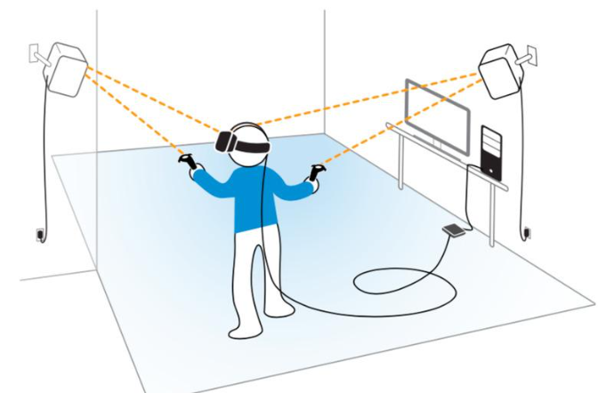
Components of Virtual Reality
Main Components
VR Headset
Motion Controllers
Sensors and Cameras
Computer or Gaming Console
VR Software and Applications
Examples:
Meta Quest
HTC Vive
PlayStation VR

Slide 4
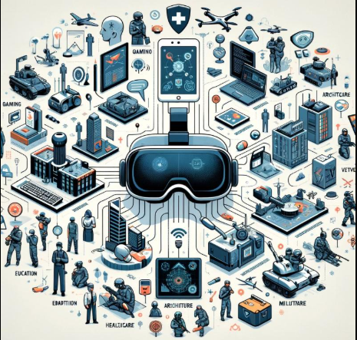
Applications of Virtual Reality
Where is VR Used?
🎮 Gaming and Entertainment
🏥 Medical Training and Surgery
🎓 Education and Virtual Classrooms
🏗 Architecture and Engineering
✈ Flight and Military Simulation
🛍 Virtual Shopping and Tourism

Slide 5
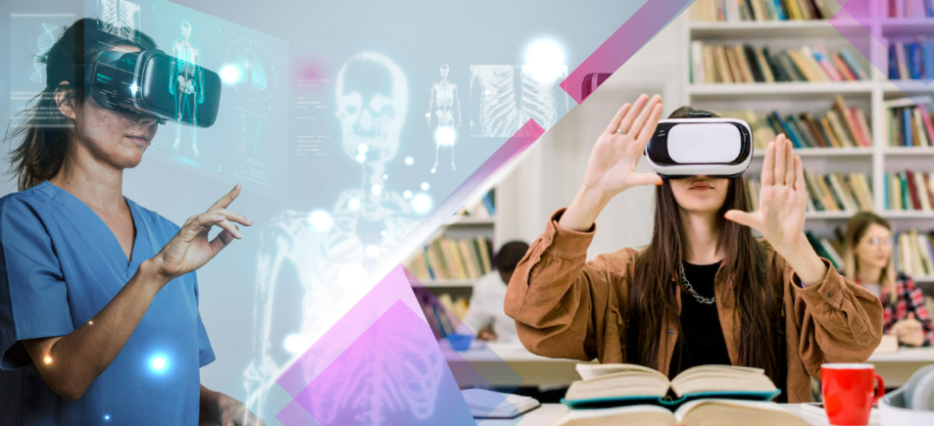
Advantages and Disadvantages
Advantages
Provides immersive learning.
Improves training and simulation.
Makes education more interactive.
Saves time and travel costs.
Enhances gaming experience.
Disadvantages
Expensive equipment.
Can cause motion sickness.
Requires powerful hardware.
Limited battery life.
May reduce real-world interaction.

Slide 6
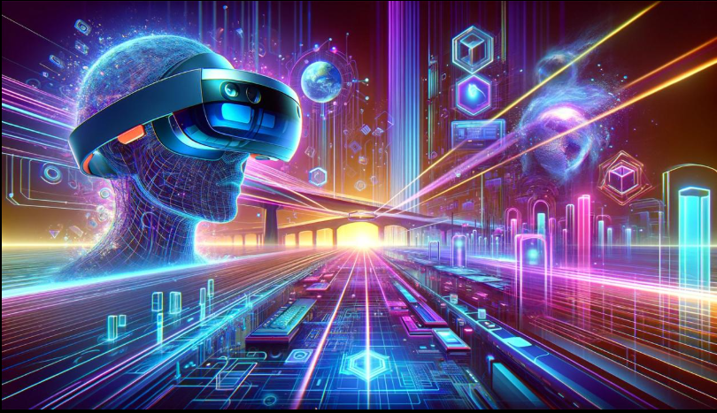
Future of Virtual Reality
Future of Virtual Reality
Future Scope
AI-powered virtual environments.
Virtual offices and remote meetings.
Better healthcare applications.
Advanced educational simulations.
Growth of the Metaverse.
More affordable VR devices.

Slide 7
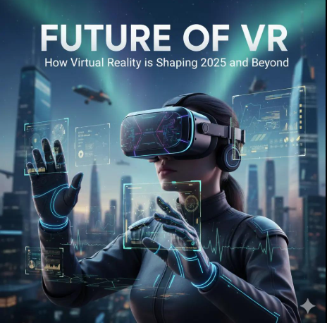
Conclusion
Virtual Reality is transforming many industries.
It provides immersive and interactive experiences.
VR is widely used in education, healthcare, gaming, and training.
As technology advances, VR will become more accessible and powerful.

Slide 8


